Slide 1
AJAX Advanced
By: Arun Rajora
(1302016)

Slide 2
What it stands for?
Asynchronous JavaScript and XML

Slide 3
An API
To communicate with server
Using HTTP request
Asynchronous (point of execution moves on).

Slide 4
XMLHttpRequest Object :
=> Create XHR Object
=> Open a connection
=> Set headers
=> Set listeners
=> send data
Demo 1
Debugging using chrome

Slide 5
Use Cases:
Load data async
Load web pages async
Send form data
Polling for new content
Signaling an activity
Infinite loading lists

Slide 6
Fetch Queue
Can be blocked by too many requests
Requests have Priority

Slide 7
Polling-
Short term polling
Long term polling
Short term waited polling

Slide 8
Server Side Rendering-
JavaScript disabled in browser.
Error in script.
JavaScript file not available due to-
Mistake in Code.
Failure of server or CDN.
Network time-out.
Blocked by proxy.
Blocked by Browser.

Slide 9
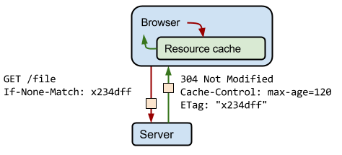
Caching
Cache Headers
E Tags (Entity Tags)

Slide 10
Single Page Applications
Problem Of Refresh
Routing

Slide 11
CORS-
Cross Origin Resource Sharing
Origin : protocol Uri port-no

Slide 12
Fetch API and polyfills-

Slide 13
Offline experience
Have some visual cue when AJAX is in progress.
Avoid the feeling of unresponsiveness when offline/slow networks.
Don’t Block The Queue!

Slide 14
Thank You

